Slide 1

San Francisco bike sharing system
Patel, Sanket
100800990

Slide 2
Background Overview
^{[1]}Bay Wheels is a regional public bicycle sharing system in California's San Francisco Bay Area. It is operated by Motivate in a partnership with the Metropolitan Transportation Commission and the Bay Area Air Quality Management District. Bay Wheels is the first regional and large-scale bicycle sharing system deployed in California and on the West Coast of the United States. It was established as Bay Area Bike Share in August 2013. As of January 2018, the Bay Wheels system had over 2,600 bicycles in 262 stations across San Francisco, East Bay and San Jose.
In June 2017 the system was officially re-launched as Ford GoBike in a partnership with Ford Motor Company. After Motivate's acquisition by Lyft, the system was renamed to Bay Wheels in June 2019. The system is expected to expand to 7,000 bicycles around 540 stations in San Francisco, Oakland, Berkeley, Emeryville, and San Jose.
^{[2]}Research and experience tell us that there can be problems with bike sharing. For example, although the usage rate of these schemes tends to vary globally between three and eight trips per bicycle per day, some facilitate as few as 0.3 trips per bicycle per day.
Despite these difficulties, bike sharing schemes are, on the whole, a win for everyone. Cities are able to enhance their image and civilians from all socio-economic classes would benefit from cleaner roads and clearer air and quicker commutes in traffic congested areas.

Slide 3
Business Problem and Main Audience
Explore the usage of bike sharing system in the city of San Francisco and explain how can we increase the usage and promote this mode of transportation mode.
Audience: VP of marketing

Slide 4




Overall Approach
Understanding the business problem
Insights about data
Understanding trends
Actions and recommendations

Slide 5

Visualization Methodology
Step 1 — Be clear on the questions.
Step 2 — Know data and start with basic visualizations.
Step 3 — Identify messages of the visualization and generate the most informative indicator.
Step 4 — Choose the right chart types.
Step 5 — Use color, size, scale, shapes and labels to direct attention to the key messages.

Slide 6
Business questions (Action oriented)
How can we increase average trip duration?
How can we increase total number of trips?
Who is our core customer? Which demographic represents them?
Knowing our customer, how can we potentially target our marketing campaign?
How can we optimize operating costs?

Slide 7
Data analysis Questions:
Below are the questions that could be asked :
What are the Stations with high usage rate.
What is the average trip duration.
Who are the users with high trip duration.
What is the Age Group of users with high usage.
Stations with high Registered users.
Start Station Name with high Trip Count.
User Types with high Trip Duration.
Popular areas using Station Lat/Long.
Average Age Group of users.
Is there any Season with high users?
Data analysis questions (Insights oriented)

Slide 8

Technology to be Used
Google cloud platform BigQuery
Tableau 2019.4

Slide 9

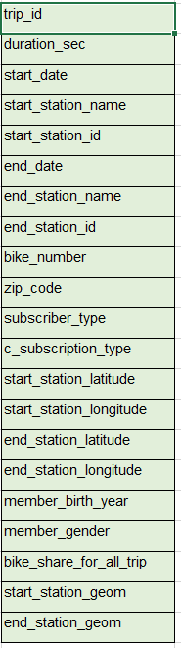
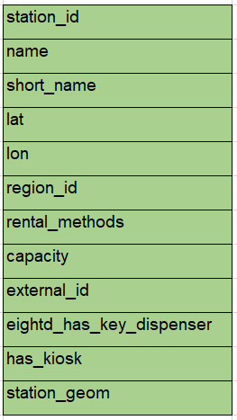
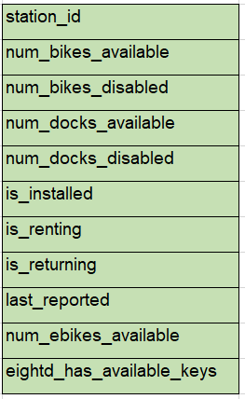

Data Sources Considered
Google Big query (public dataset): Dataset Link
Contains 4 tables:
bikeshare_regions (Region Level table)
bikeshare_station_info (Station level table)
bikeshare_station_status (Status of stations for bike mapping)
bikeshare_trips (Individual Trip Level)

Slide 10
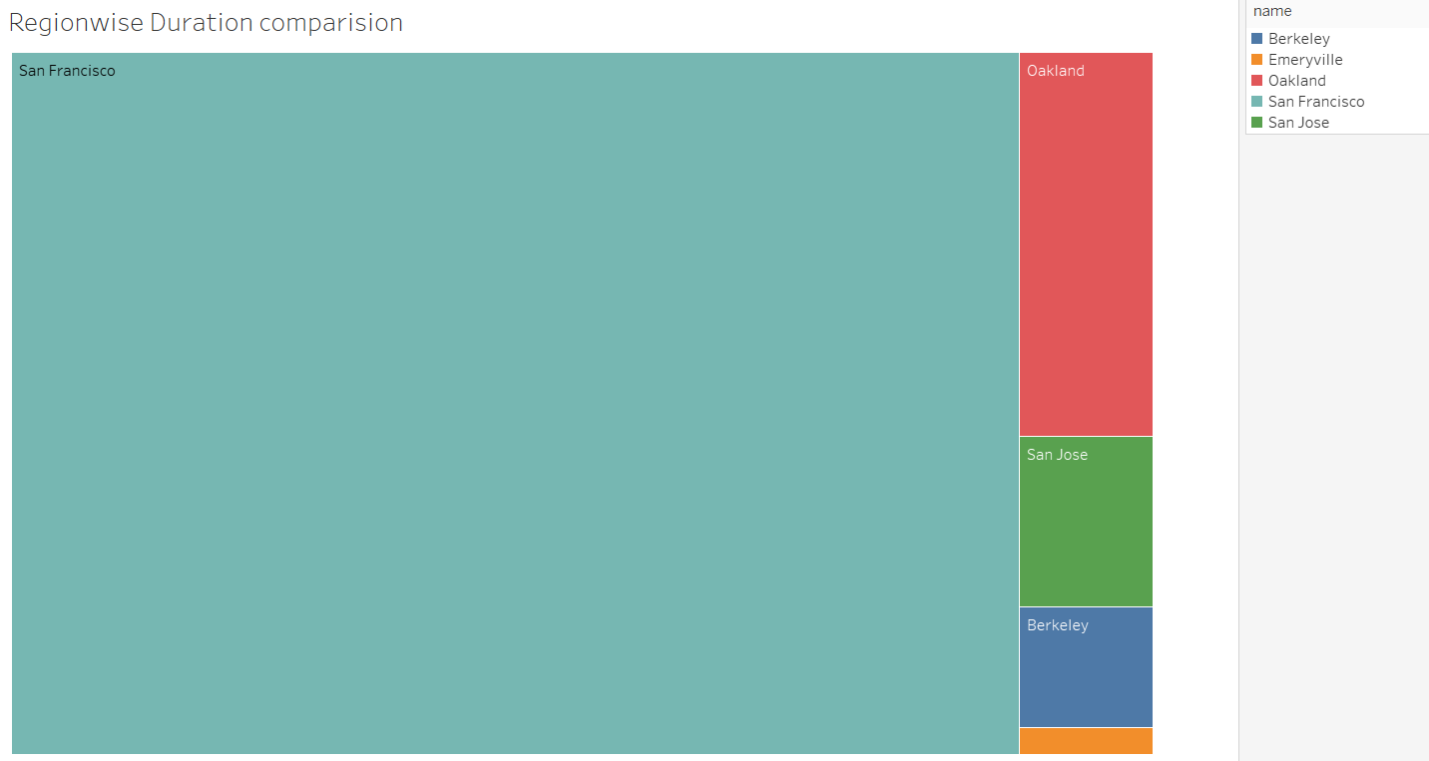
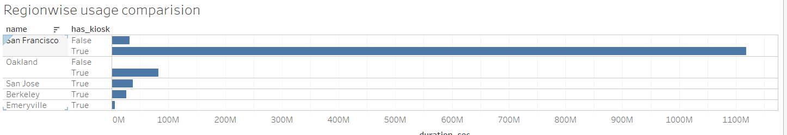
What are the regions with high usage rate?
San Francisco is the biggest region we’re currently serving.
Other regions are comparable.
Having a kiosk makes a HUGE difference.

Slide 11
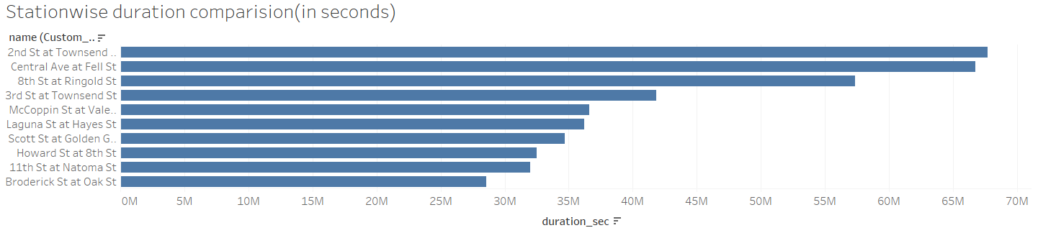
What are the Stations with high trip duration
Second Townsend, Central at Fell, 8h ST at Ringold st are the most important stations where the most trip duration occurs.

Slide 12
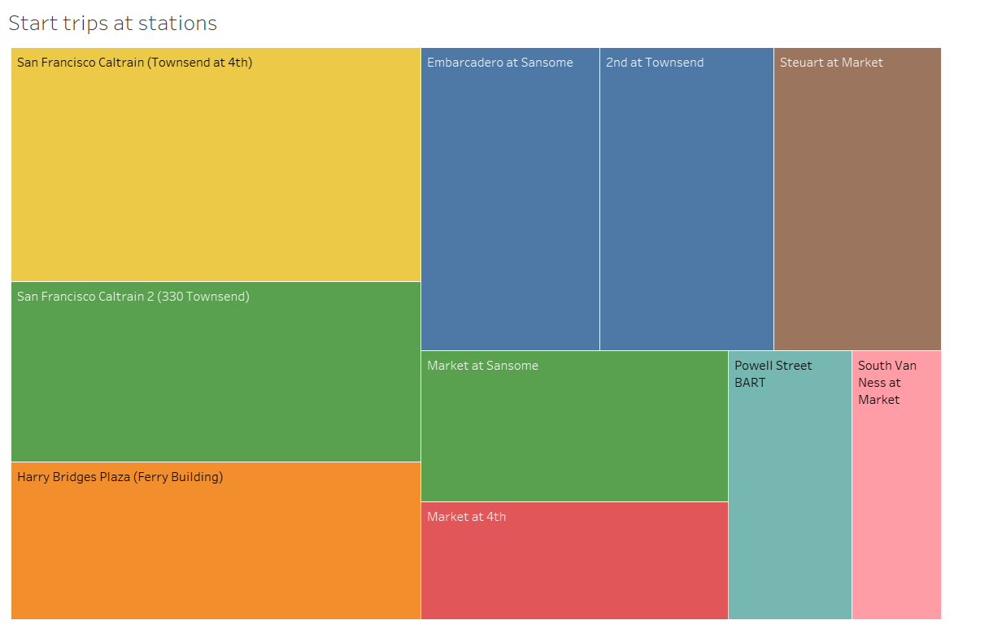
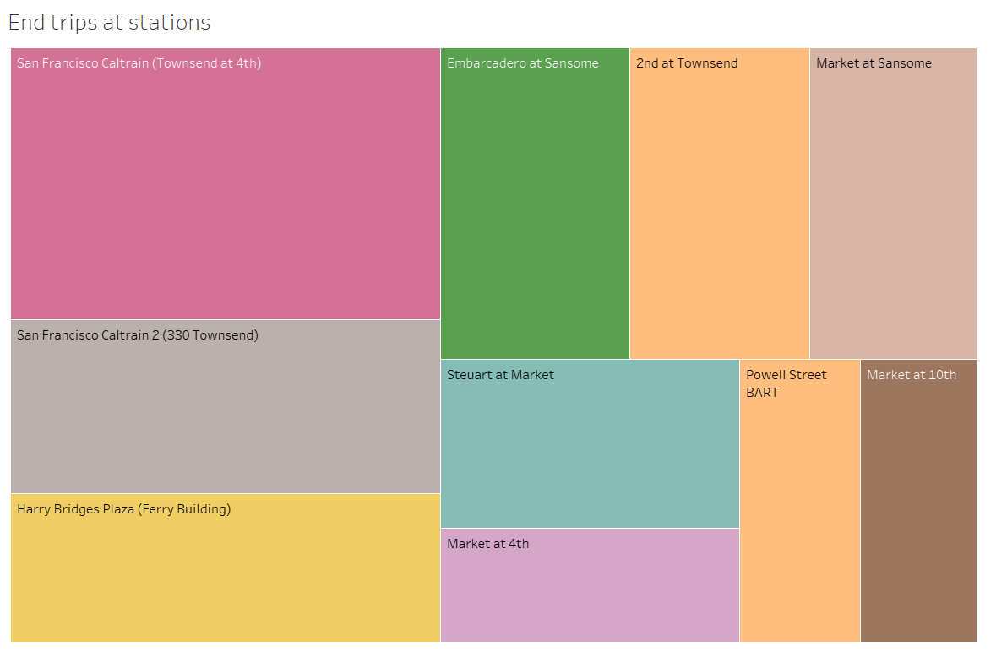
Start and end trip counts at stations
On the basis of trip level counts, these top 10 stations are the most important ones.
Hence, they need to have more number of bikes.

Slide 13
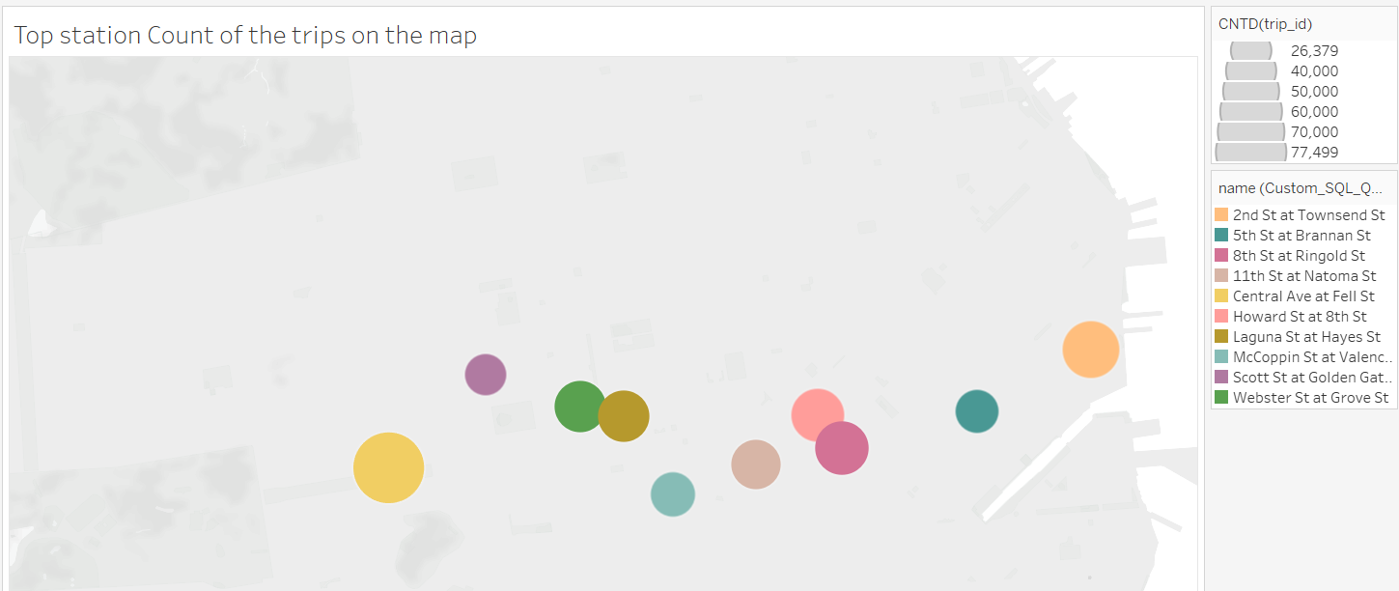
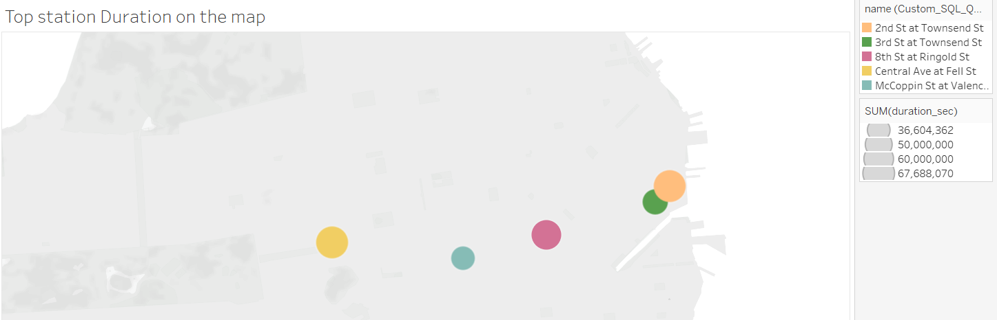
Station wise comparison on Bay area map:
Near to shore, total duration of trip is more.
Near to the center, total count of trips is more.

Slide 14
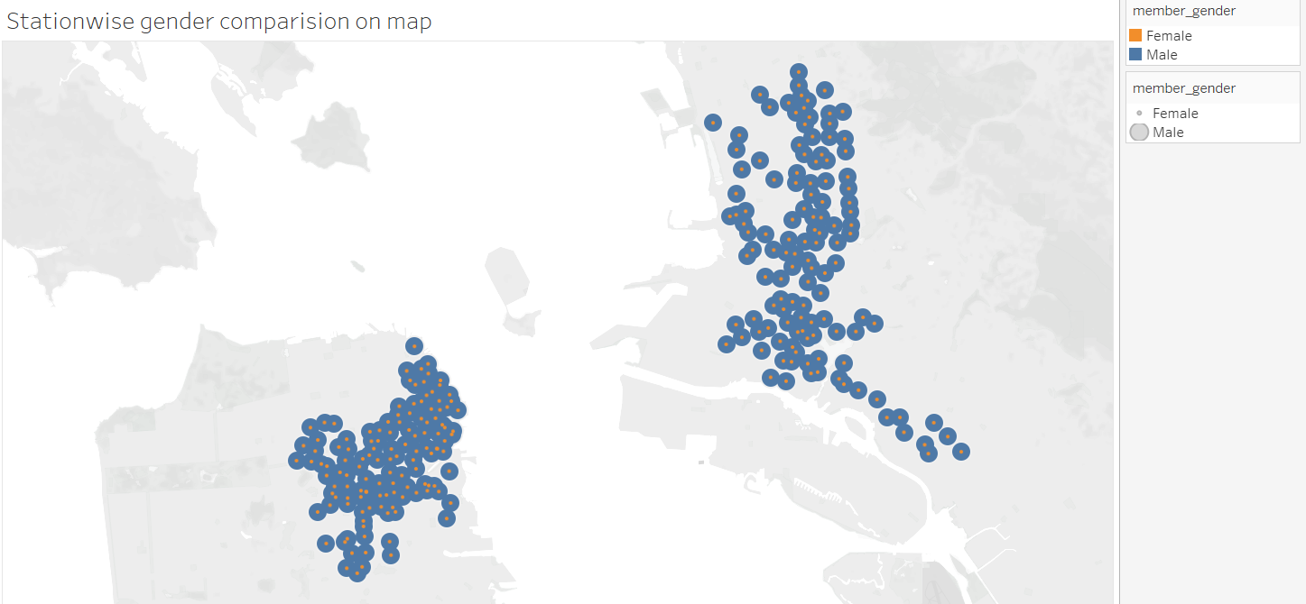
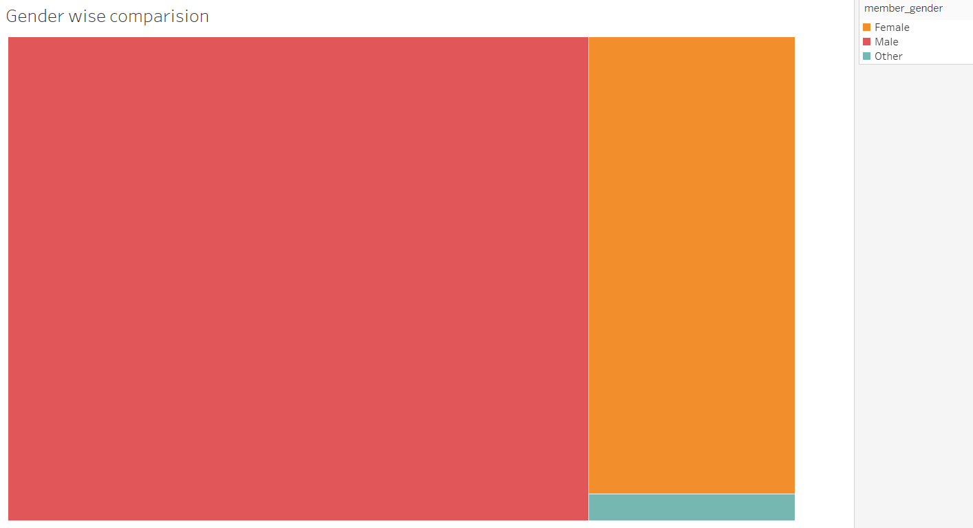
Gender wise comparison of total usage
Males are using the services significantly more than females.
Not only overall, but also on individual station level.

Slide 15
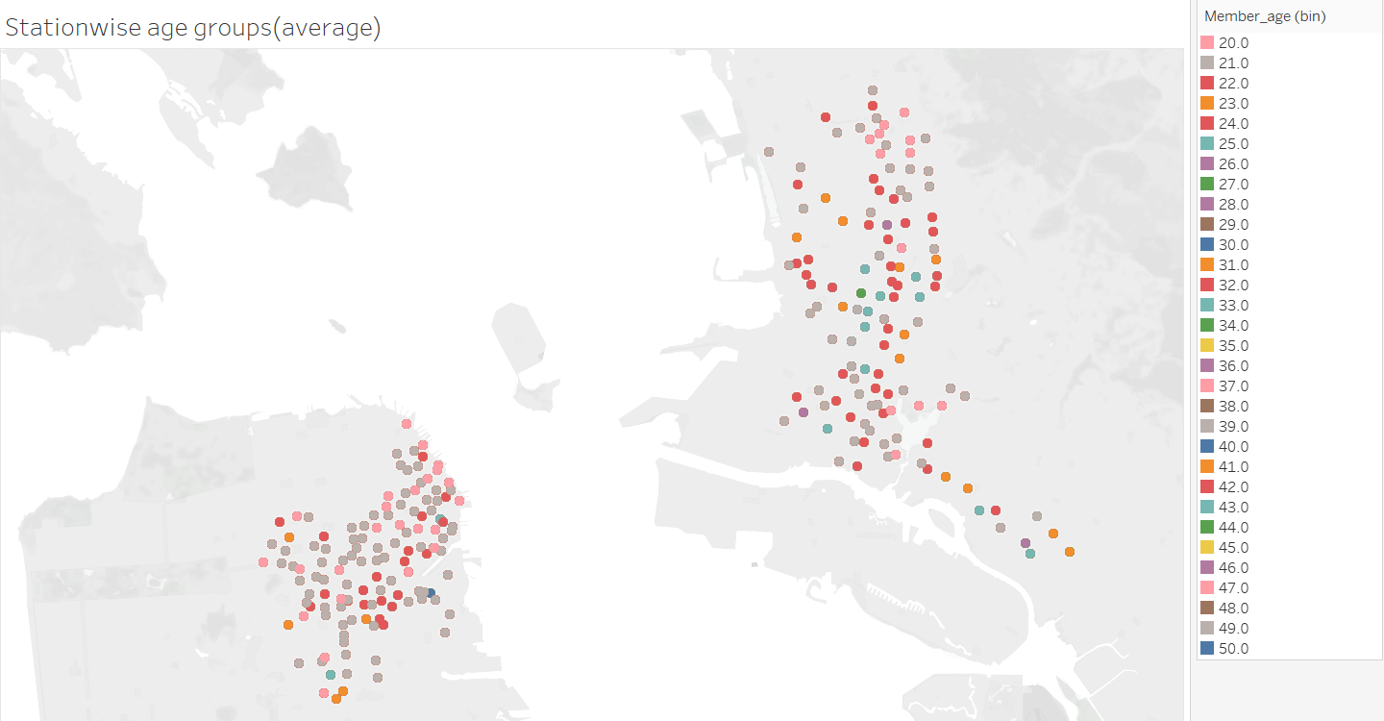
What is the Age Group of users with high usage?
As we can see, our target group is between the age of 20-27.
So, youngsters are more likely to use our services

Slide 16
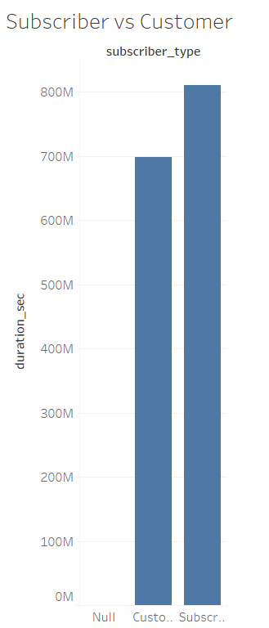
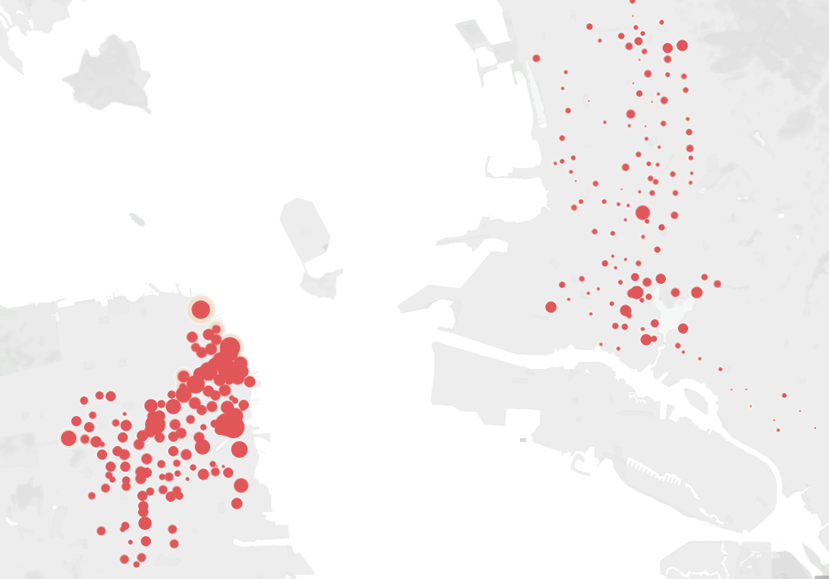
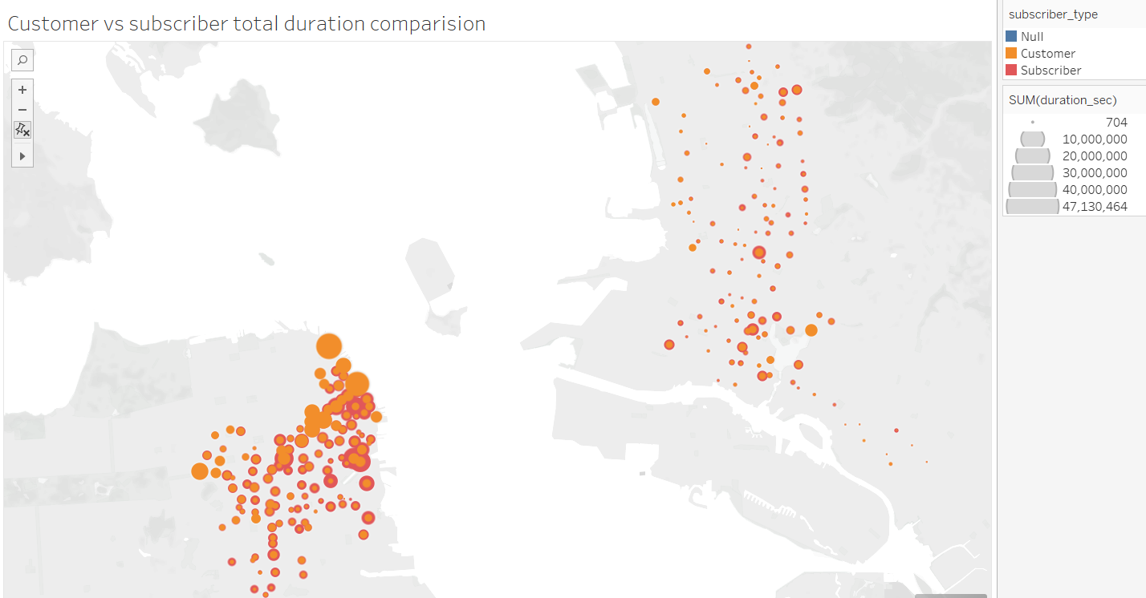
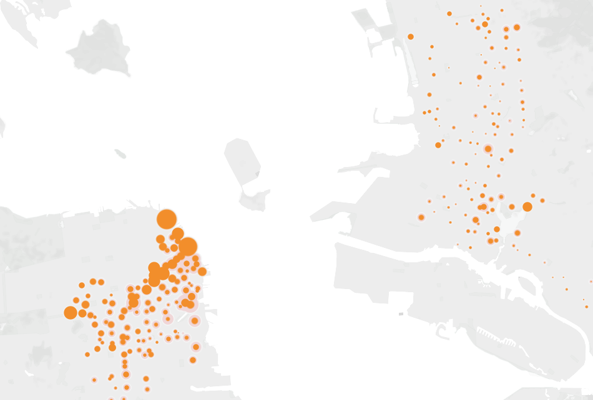
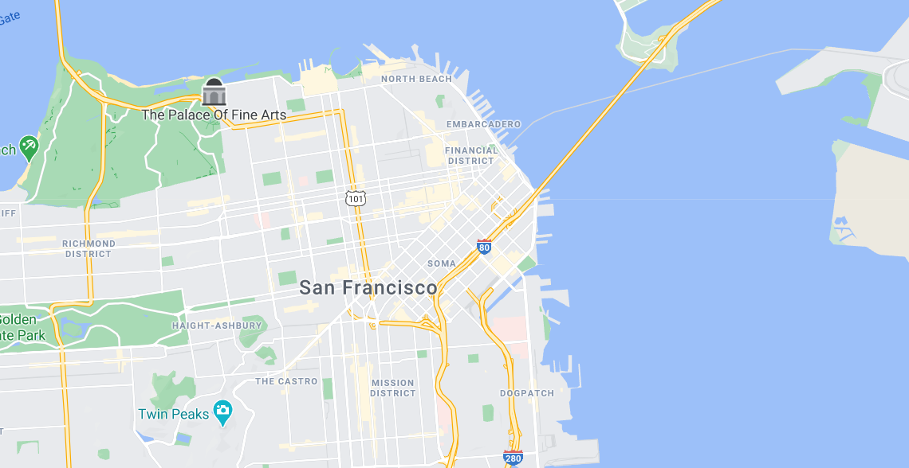
On-the-go-Customer vs Subscriber
There are 100 million more subscribers than the customers overall.
However, as we move towards North beach, customers are more than subscribers.

Slide 17
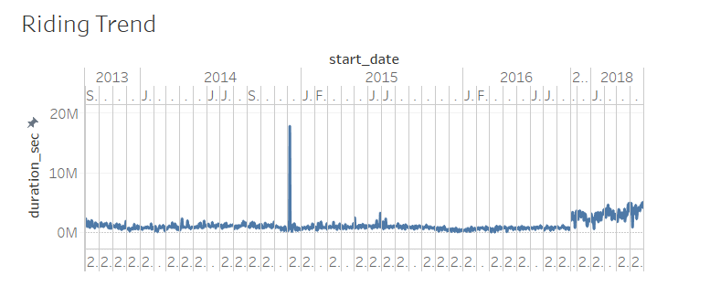
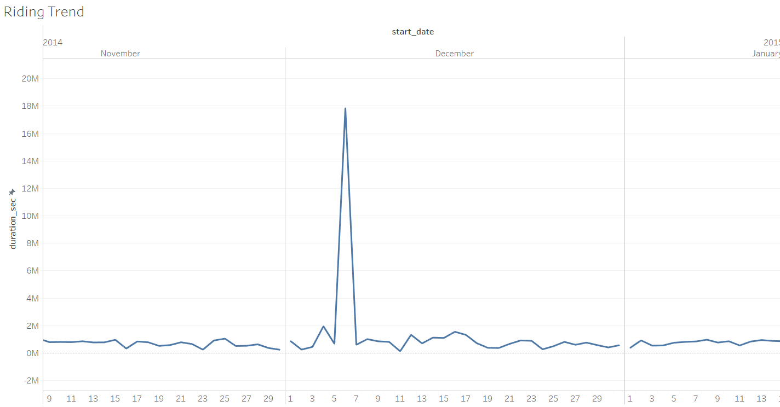
Trend & Seasonality
No Seasonality present.
However, one particular spike stands out.
We can investigate further on what happened during the first week of December 2014.
We can also investigate why trend started going up after the year 2017 and keep taking the same or better actions.

Slide 18
Conclusions and recommendations
Adding a kiosk will make a whole lot of difference in trip duration.
Investigate why people away from the shore, even though they’re making more trips, aren’t making trips for longer duration.
Females use far few rides than men. So, we need to shape our marketing campaign in a unisex manner.
Our target group is young. So, marketing campaign should reflect the “essence of youth” and assess what young people really want.
Since as we move towards North beach, customers increase more than subscribers, we can target those customers and provide them better deals to subscribe. This will ensure continual engagement of customers.
We can investigate further on what happened during the first week of December 2014.
We can also investigate why trend started going up after the year 2017 and keep taking the same or better actions.
Workbook links:
All levels
Individual trip level

Slide 19
Thank you

